Slide 1
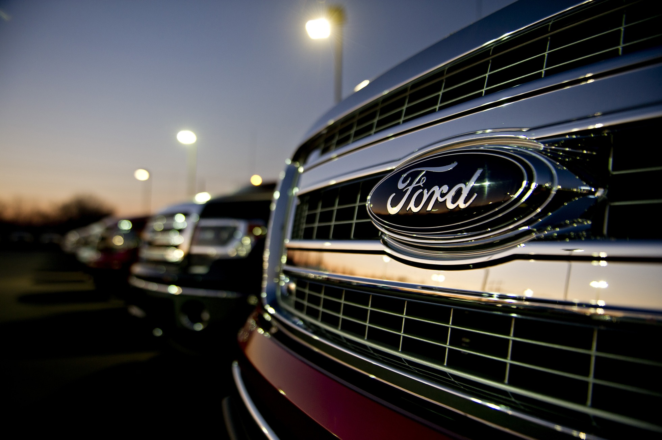
Supply Disruptions Through Chip Shortage at Ford Motor Company

Slide 2

Introducing myself
Pooja Shah
Supply Lead
1.

Slide 3
TOC
Problem Statement
Project Scope and Objectives
Key Stakeholders
Key Performance Indicators
Overview: Ford Motor Company
Strategic objectives
Operational challenges
Risks
ESG responsibilities with Suppliers
SWOT analysis
Quadrant Analysis: Understanding the Spend Categories
Issues at a glance
Supplier Offshore vs onshore
Onshore and offshore risk-benefit analysis
Insourcing vs outsourcing
Supplier selection
Formal supplier evaluation
Supplier selection criteria
Supplier code of conduct and contract considerations
Recommendations
2.

Slide 4
Problem Statement
To identify sustainable long-term solution to chip shortage:
Ford, the automaker, has been struggling with a shortage of computer chips, which has choked off vehicle production for much of the last two years costing an additional 1$ billion a quarter
1.
2.
To identify cost-effective supplier partnerships to deliver business growth:
With the massive blow on production due to shortage, it is critical to evaluate sustainable and cost-effective partnerships to deliver business growth
3.
Notes:
Currently, Ford faces supply chain uncertainty and instability. In an interview in late 2022, Ford CEO Jim Farley reported various Ford supply chain ailments: inventories remained low, there was a parts shortage, product launches were delayed, and challenges constrained V8 engine production.
Workforce shortages also abound as suppliers face labor difficulties and struggle to maintain shipping schedules and quotas. Raw material costs have increased, while semiconductor chips (necessary in every industry and sector) are in short supply. Some of these problems result from the COVID-19 pandemic, and others to inflation.

Slide 5
Project Scope and objectives
Identify critical areas of Ford's production and supply chain affected by the chip shortage.
Develop a comprehensive understanding of the semiconductor supply chain dynamics and constraints.
Provide a foundation for long-term supply chain resilience against future disruptions.
1.
2.
3.
Identification of problem
Understanding Supply Chain dynamics
Finding long-term strategy
4.
Notes:
It may be impossible to predict when such issues may end — Farley says he's "stopped forecasting" and focuses on becoming "more efficient in helping our suppliers find labor" and overcoming other related hurdles. As always, adversity inspires innovation, and Ford has "developed a bit of a rhythm" in dealing with challenges.

Slide 6
Key stakeholders
Leadership Team at Ford
Buyers and Procurement Team
Finance and Control
Customer
Manufacturing Team
Project Team
Quality Team
Supply Chain and Logistics
5.

Slide 7
Key Performance Indicators
Vehicle Production Rate
Chip Out of Stock %
Production Efficiency
% Profit Margin
Change in Revenue ($)
Customer Satisfaction
% Sales Contribution
% Increase in Growth from impacted models
6.

Slide 8

Overview: Ford Motor Company
What?
When?
Is an American multinational automobile manufacturer headquartered in Dearborn, Michigan, United States.
Was founded in 1903 by Henry Ford.
Future?
Ford is dedicating more than $50 billion from 2022 through 2026 to develop and manufacture electric vehicles and batteries.
Crisis?
How?
During the COVID pandemic, the company experienced a major production disruption due to a shortage of chips used in automobile manufacturing
Ford Motor Company was incorporated with 12 investors owning 1000 shares with a purpose to help build a better world
7.

Slide 9






Strategic Objectives
Innovation and Sustainability
Drives product development
Customer centricity
Drives market development
Growth and value creation
Drives product development
Operational efficiency
Drives business competitiveness
Cost Leadership
Global expansion
Drives market penetration
Diversification of Mobility Service
Drives market penetration
8.

Slide 10


Operational Challenges
Supply Disruptions
Chip shortages were triggered during the pandemic and continuing to mount ever since
Chipmakers shifting shipments to the consumer electronics industry
Slow improvement in supplies as shortages enter in 3rd consecutive year
Battery shortages leading to production disruption
Competition
Facing competition from both traditional automakers and new entrants in the electric and autonomous vehicle sectors
Higher net prices owing to higher material costs leading to a competitive disadvantage
Threat of competitors, such as General Motors, Toyota, Tesla, Volkswagen, and Mercedes-Benz, along with Honda, Nissan, and Hyundai
Technological Disruption
Adapting to rapid advancements in electric vehicles, autonomous driving, connectivity, and artificial intelligence
Threat of competition involving driverless or autonomous driving technologies from Apple, Alphabet (Google)
9.
Notes:
Ford and other automakers dialed back production after the COVID-19 pandemic hit in 2021 and chipmakers responded by shifting shipments to the consumer electronics industry. The auto industry has been playing catch-up ever since, although some companies have talked about a slow improvement in supplies as the shortage enters its third year.

Slide 11
Risks
Strategic Risk
Customer Dis-satisfaction
Market Demand Fluctuations
Disrupted product mix
Failure to deliver product on time
Financial Risk
Budget Overruns
Revenue Loss
Short-term gains impacting long-term benefits
Suppliers quoting higher prices due to shortages
Reputational Risk
Loss of reputation due to non – serviceability of demand
Quality issues due to substitutes
10.
Notes:
Ford and other automakers dialed back production after the COVID-19 pandemic hit in 2021 and chipmakers responded by shifting shipments to the consumer electronics industry. The auto industry has been playing catch-up ever since, although some companies have talked about a slow improvement in supplies as the shortage enters its third year.
Left billions of dollars on the table that were within its control and blamed a 100,000 vehicle shortfall in its fourth-quarter volume mostly on the inability to obtain enough chips.

Slide 12



ESG Responsibilities with Suppliers
Environmental
Social
Governance
Greenhouse gas reduction target to be scope 1 & 2 carbon neutral by 2035
Mandatory Environmental training
Reduce waste by using recycled materials
Preserve biodiversity
Zero emissions from vehicles and facilities
100% carbon-free electricity by 2035
Human Rights Policy
Access to sanitation
Fair, equal, living wages
Prohibit child labor and slavery
Prohibition of human trafficking
Prevent discrimination and harassment
Provide safe working environment & hours (<=60)
Responsible sourcing
Training to ensure ethical and sustainable practices
Ford Code of Conduct
Supplier Code of Conduct
Suppliers must comply with laws and regulations as well as Ford policies
Global Terms and Conditions: Suppliers must enforce a similar code of practice
Refrain from bribery & corruption
Supply Chain Transparency
11.

Slide 13




SWOT Analysis
Strength
Strong brand image
Weakness
Limited global scope of production network
Threat
Aggressive competitive rivalry
Opportunity
Global expansion through market penetration
Global supply chain
Effective innovation processes
Higher costs compared to competitors
Slow innovation processes
Growth through product development
Cost reduction through strategic supply chain management
New entry of high-tech firms
Fluctuating or unstable supplies of critical parts
12.

Slide 14
Quadrant Analysis: Understanding the Spend Categories
Bottleneck: CHIPS
• Unique specification.
• Supplier’s technology is important.
• Production-based scarcity due to low
demand and/or few sources of supply.
• Substitution is difficult.
• Usage fluctuates/is not routinely predictable.
• Potential storage risk.
Strategic: AUTOMOBILE parts
• Continuous availability essential.
• Custom design or unique specifications.
• Supplier technology is important.
• Few suppliers with adequate technical
capability or capacity.
• Switching suppliers is difficult.
• Substitution is difficult.
Noncritical: METAL / Tyres, etc.
• Standard specification or commodity-type
items.
• Substitute products readily available.
• Competitive supply market with many
suppliers.
Leverage: Other ELECTRONIC components
• Unit price management is important
because of the volume of usage.
• Standard specification or commodity-type
items.
• Substitution is possible.
• Competitive supply market with several
suppliers.
Risk
Value
13.

Slide 15



Issues at a glance
Global Chip Shortage
Labor Shortage
Demand > Production Capacity
14.

Slide 16
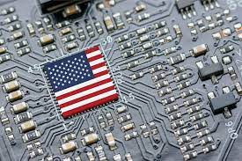
Supplier Offshore vs Onshore
Onshore Considerations
Ford would not have to compete with other companies with their own factory producing chips (or partnership with suppliers). Advantages can be considered as below:
Gain a competitive advantage over other automakers
More reliable
Increased flexibility in fulfilling the demand
Easily visit plants & meet with executives
Benefits local community
15.

Slide 17
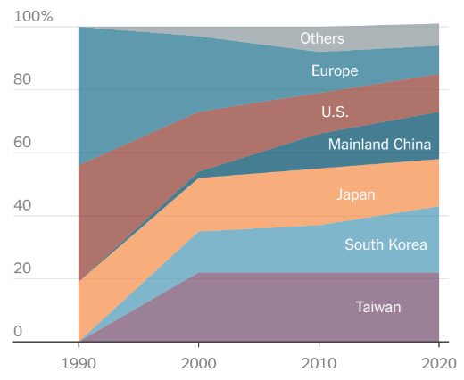
Supplier Offshore vs Onshore
Offshore Considerations
Ford mostly operates offshore already: Over 60 factories globally & only 8 in the U.S.
Specialize in automobiles, not chips
Majority of chips are produced in Asia
Global Semiconductor Manufacturing Capacity
Possible Courses of Action
Modify chips to work with what is currently available in the market
Modify vehicles to use fewer chips
Open additional facilities in Asia / expand the network of suppliers
Source: VLSI Research, SEMI, BCG & The New York Times
16.

Slide 18

Supplier Offshore Risk-Benefit Analysis
Risks
Benefits
Supply disruptions (weather, raw material shortage, COVID, etc.)
Cultural & language barriers
Difficult to enforce quality control
Supplier: More technical expertise
Ford: Focus on manufacturing high-quality vehicles & continuous improvement
Lower operating costs (wages & materials)
Less strict labor restrictions
Compete globally
Ford would benefit more by continuing to produce chips offshore in order to remain competitive in the global market.
17.

Slide 19
Supplier Onshore Risk-Benefit Analysis
Risks
Benefits
Higher labor costs & taxes
Strict regulations that could hinder production
Time-consuming & timeline disruption
Expenses > revenue
Lower quality product
Invest in new technology
Limited skilled labor available
Decreased time to market
More control over quality
Easier communication
Reduced lead times
Lower transportation costs
Creates jobs for the local community
As Ford already operates majority of facilities offshore, it would be more cost efficient and less risky to continue working with these offshore suppliers who specialize in chips.
18.

Slide 20
Insourcing vs Outsourcing
Chips used in automobile
Business opportunity
What product or service to create in which market segment?
Strategic entrepreneurial
Execution
What do we make or buy?
Strategic operational
100% Make
Gray zone
100% Buy
Change
Change
Stay
Change
Stay
Stay
20%
80%
19.

Slide 21

Supplier Selection
Ford has more than 1100 tier 1 suppliers. Their Key Chip Suppliers are –
STMicroelectronics and NXP Semiconductors in Europe, Renesas Electronics in Japan, On semi and Microchip Technology in the United States
All suppliers were compelled to cease operations due to a worldwide crisis, resulting in the inability to accumulate stocks of products and solutions for resumption of business activities.
The shortage of chips was exacerbated by a fire at a facility owned by Renesas Electronics, a chip manufacturer, in Japan.
Mitigation Strategy
Collaboration with GlobalFoundries to Address Chip Shortage
Preventing Production Delays and Maintaining Affordability
20.

Slide 22
Impact of Supply Chain Disruptions on Supplier KPIs:
Formal Supplier Evaluation
1.
Wafer Production:
Challenge: Disruption in the supply chain impacts wafer production.
Effect: Decreased ability to meet demand for semiconductor chips.
Capacity Shift:
Challenge: Shift of capacity from automotive to consumer electronics sector.
Effect: Decreased utilization in automotive, increased utilization in electronics.
Shipment Volume:
Challenge: Diversion of chips and wafers to consumer electronics.
Effect: Reduced shipment of chips to automotive manufacturers.
Average Price:
Challenge: Supply-demand gap due to diverted capacity.
Effect: Increase in average selling price of car due to increased demand and low supply
Total Wafers Revenue:
Challenge: Focus on consumer electronics due to demand surge.
Effect: Decreased revenue from automotive wafers.
21.

Slide 23
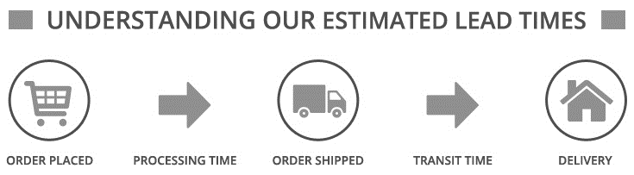
Understanding the delivery lead time:
Formal Supplier Evaluation
2.
26 weeks are needed to build chips pre-installation.
If we wait another 26 weeks from the time the chip-making plans were set, we reach a point where there weren't enough chips available for cars.
This shortage issue affected the automotive industry from the middle of the year before and carried on into the first part of the following year.
26 weeks
22.

Slide 24
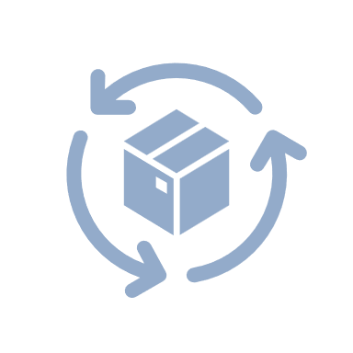


Relationship with Suppliers:
Formal Supplier Evaluation
3.
Matched Pairs Systems : aligns product development and purchasing, enhancing collaboration and simplifying communication.
Aligned Business Framework : accelerates supplier innovations, promoting direct engagement and early involvement in design.
Executive Business Technology Review : senior leaders explore suppliers' latest tech, aiming to introduce cutting-edge features to global drivers. Notable technologies like hands-free liftgates and lane-keeping systems have debuted through this process.
23.

Slide 25
Supplier Selection Criteria
1. Supplier Identification: Aligning products, services, and capabilities with Ford's needs.
2. Initial Screening: Assessing financial stability, production capacity, and regulatory compliance.
3. Request for Information (RFI): Ford may send out RFIs to shortlisted suppliers to gather detailed data on capabilities, quality control, technology, and other practices.
4. Request for Proposal (RFP): Qualified suppliers may be asked to submit formal proposals detailing their quotations, pricing, delivery schedule, and quality assurance.
5. Site Visits and Audits: Ford may conduct on-site visits to supplier facilities to assess their manufacturing processes, quality control systems, and overall operational capabilities.
6. Performance Monitoring: Ford continuously monitors their performance. This could involve regular performance reviews based on factors like on-time delivery, quality, and responsiveness to issues.
7. Long-Term Relationship: Ford Frameworks for maintaining long term relationship.
24.

Slide 26
Supplier Code of Conduct and contract considerations
1. Human Rights:
Suppliers must treat workers ethically, provide safe conditions, and prevent child labor, forced labor, and harassment.
2. Environment:
Compliance with Ford's environmental policies, Paris Climate Agreement alignment, carbon neutrality goals, and use of recycled and renewable materials.
3. Material Sourcing:
Suppliers must responsibly source, verify compliance with Ford's Responsible Materials Sourcing Policy, and enhance transparency in conflict-affected or high-risk areas.
4. Business Ethics:
Suppliers must avoid bribery and corruption, maintain privacy and cyber-security practices, and adhere to trade and custom regulations.
25.

Slide 27
Recommendations
1.
Collaborate with semiconductor suppliers to enhance communication and prioritize Ford's chip needs
2.
Minimize production delays and increase inventory levels of materials running in short supply
3.
Adopt a partnership model with 20% of business allocation of supplies being delivered through in-house manufacturing
4.
Allocate 80% of business to suppliers for procurement of critical supplies
26.
Notes:
1. Support Efficiency from Multiple Angles
Ford's innovations shaped global work culture. The company created the modernized assembly line and spearheaded the truncated work-week and the abbreviated work-day to boost efficiency from multiple angles.
2. Roll with the Punches
Cliches shouldn't always be observed, but sometimes they reveal essential truths. As Ford CEO Jim Farley says, in response to manufacturing curveballs, "I don't think the labor market's going to ease any time soon … we're kind of running our business now and have developed a bit of a rhythm around [these] challenges that we're seeing." Challenges may be unpredictable and inevitable, so the onus is on adaptability.
3. Continue Evolving
The Ford assembly line was realized by pondering what could be. Ford adheres to this principle today, pushing to achieve ecological accomplishments, and is set to achieve carbon neutrality no later than 2050. From 2017 to 2022, Ford reduced manufacturing facility emissions by 40%, and in 2022, 60% of its electricity was carbon-free. One way it has done so is by conducting "30 supplier audits along select critical mineral battery supply chains at all tiers to the mine site."
4. Embrace the Wave of the Future
Ford is embracing the EV market, sourcing battery capacity and raw materials to manufacture 600,000 new EVs by 2023 and more than 2 million by the end of 2026. The expected run rate for new EVs by late 2023 includes the following:
270,000 Mustang Mach-E SUVs
150,000 Transit EV vans
150,000 Lightning F-150 trucks
30,000 new yet-to-be-specified SUV vehicles

Slide 28
References
Ali, B. J., & Anwar, G. (2021). Porter’s Generic Competitive Strategies and its influence on the Competitive Advantage. International Journal of Advanced Engineering, Management and Science, 7(6), 42-51.
Boudette, N. E. (2022, September 19). Ford says it will spend $1 billion more in third quarter because of supply chain problems. The New York Times. https://www.nytimes.com/2022/09/19/business/ford-supply-chain.html
Britannica, T. Editors of Encyclopaedia (2023, July 2). Robert S. McNamara. Encyclopedia Britannica. https://www.britannica.com/biography/Robert-S-McNamara
Climate Change Report. Ford Corporate (n.d.).
https://corporate.ford.com/content/dam/corporate/us/en-us/documents/reports/2023-climate-change-report.pdf
F-20221231. SEC.gov. (n.d.).
https://www.sec.gov/Archives/edgar/data/37996/000003799623000012/f-20221231.htm
Eckert, N. (2022, September 23). Ford’s latest supply-chain problem: A shortage of Blue Oval Badges. The Wall Street Journal.
https://www.wsj.com/articles/fords-latest-supply-chain-snarl-not-enough-blue-oval-badges-11663944141
Farkas, I. (2023, May 10). 4 Supply Chain Lessons from Ford Motor Company. Thomasnet® - Product Sourcing and Supplier Discovery Platform - Find North American Manufacturers, Suppliers and Industrial Companies. https://www.thomasnet.com/insights/ford-supply-chain/
27.

Slide 29
Foote, B. (2023, June 28). Ford CFO says supply chain issues easing, but not completely. Ford Authority. https://fordauthority.com/2023/06/ford-cfo-says-supply-chain-issues-easing-but-not-completely/
Ford Motor Company Global Modern Slavery and human trafficking ... (n.d.-b). https://corporate.ford.com/content/dam/corporate/us/en-us/documents/legal/global-modern-slavery-and-human-trafficking-transparency-statement.pdf
The Ford Motor Company. (2014, August 7). Ford, Suppliers Help Develop Industry-First Technologies for Mustang, F-150; Working Together Key to Ford’s Aggressive 2014 Product Launches. Ford Media Center. https://media.ford.com/content/fordmedia/fna/us/en/news/2014/08/07/ford-suppliers-help-develop-industry-first-technologies.html#:~:text=Strong%20ties%20with%20suppliers,in%20vehicles%20the%20company%20sells
Ford Motor Company. (2023, May 22). Company Says Ford+ is Maximizing Value for Customers, Improving Business Resilience, Efficiency, Growth, Margins. Ford Media Center. https://media.ford.com/content/fordmedia/fna/us/en/news/2023/05/22/company-says-ford--is-maximizing-value-for-customers--improving-.html
Ford Supplier Code of Conduct - Ford Corporate. (2023, July). https://corporate.ford.com/content/dam/corporate/us/en-us/documents/operations/governance-and-policies/Ford_SupplierCodeOfConduct_2023_FINAL_v2.pdf
Governance & Policies. Ford Corporate. (n.d.-a).
https://corporate.ford.com/operations/governance-and-policies.html
Isidore, C. (2022, September 20). As many as 45,000 fords can’t be sold because they’re missing parts. CNN. https://www.cnn.com/2022/09/20/business/ford-supply-chain-problems/index.html
28.

Slide 30
Klayman, B., & Nellis, S. (2023, February 3). Focus: Ford’s pain underscores uneven impact of two-year auto chip shortage. Reuters.
https://www.reuters.com/business/autos-transportation/fords-pain-underscores-uneven-impact-two-year-auto-chip-shortage-2023-02-03/
Lampón, J. F., & Muñoz-Dueñas, P. (2023). Are sustainable mobility firms reshaping the traditional relationships in the automotive industry value chain? Journal of Cleaner Production, 413, 137522.
LaReau, J. L. (2021, September 23). Everything you need to know about the chip shortage that’s plaguing automakers. Detroit Free Press. https://www.freep.com/story/money/cars/2021/06/15/car-chip-shortage-2021/7688773002/
Mockett, A. (2021, July 20). A brief history of Ford Motor Company. OSV.
https://www.osv.ltd.uk/brief-history-of-ford/
On the road to better helping build a better world - ford corporate. (n.d.-c). https://corporate.ford.com/content/dam/corporate/us/en-us/documents/reports/2023-integrated-sustainability-and-financial-report-summary.pdf
SelectUSA Automotive Industry. International Trade Administration | Trade.gov. (n.d.). https://www.trade.gov/selectusa-automotive-industry
Sorkin, A. R., Karaian, J., Kessler, S., Gandel, S., Merced, M. J. D. L., Hirsch, L., &amp; Livni, E. (2021, November 19). Ford has a D.I.Y. Plan for Computer Chips. The New York Times. https://www.nytimes.com/2021/11/19/business/dealbook/ford-computer-chips.html
29.

Slide 31
Stanislaus, M. (2016, March 23). Resource efficiency: Lessons from Henry Ford on doing more with less. World Economic Forum. https://www.weforum.org/agenda/2016/03/resource-efficiency-henry-ford-manufacturing/
Wayland, M. (2021, February 11). How Covid led to a $60 billion global chip shortage for the auto industry. CNBC. https://www.cnbc.com/2021/02/11/how-covid-led-to-a-60-billion-global-chip-shortage-for-automakers.html
Wayland, M. (2022, September 23). Ford’s supply chain problems include Blue Oval badges for F-Series pickups. CNBC. https://www.cnbc.com/2022/09/23/fords-supply-chain-problems-include-blue-oval-badges-for-f-series-pickups.html
Welcome. Ford Corporate. (n.d.). https://corporate.ford.com/home.html
30.

